Slide 1
Generative AI Overview
December 4, 2023 Dell

Slide 2
Python for Data Science
intro video

Slide 3
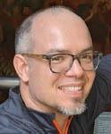
Your python instructor
Dr. Gunnar Kleemann runs a small friendly data science shop, Austin Capital Data. Gunnar has over 25 years of experience teaching a broad array of STEM fields; acting as a teacher and advisor to students in a number of contexts at institutions including at The Princeton University Genomics Institute, Barnard College, Albert Einstein College of Medicine, the University of Nebraska-Lincoln, K2, Data Society, the Princeton Review, and of course Accelebrate. Most recently he has been a Lecturer at UC Berkeley’s Master’s in Data Science (MIDS) program since 2016.
Gunnar is primarily interested in making the benefits of data science more broadly accessible since he believes that data science skills will be the core delimiters in the future world. To this end, he regularly presents his results at international conferences, most recently at All Things Open 2021. Gunnar has published research on physiological and behavioral genomics in the most prominent international journals, including Cell, Genetics, and the Journal of Neuroscience

Slide 4
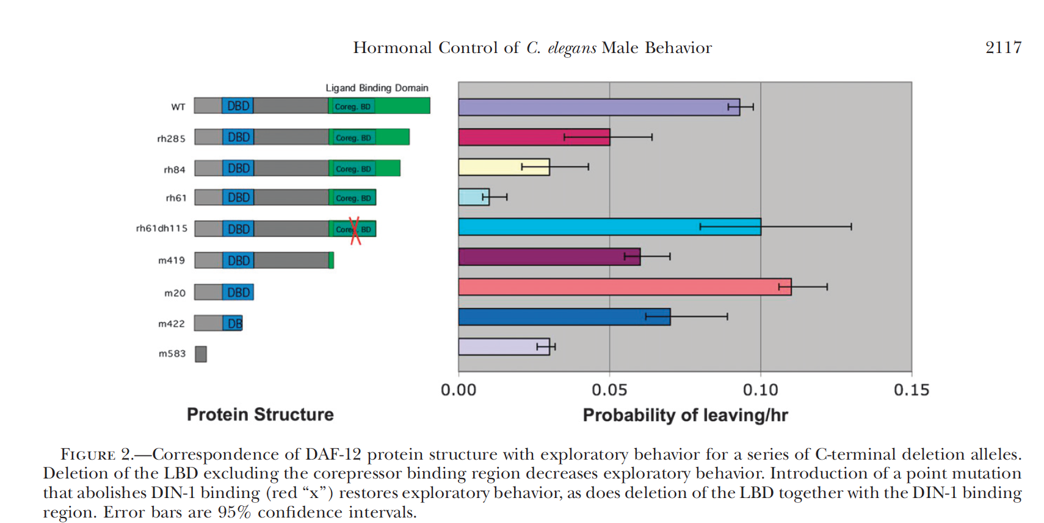
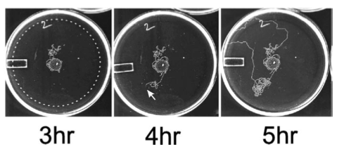
Gunnar Kleemann’s research background
Genomics of longevity and behavior C.elegans
https://www.linkedin.com/in/gunnarkleemann/

Slide 5
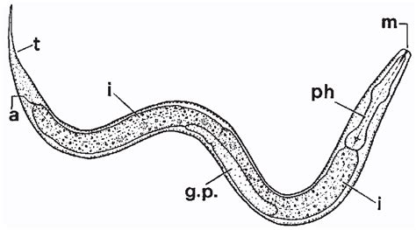
Gunnar Kleemann’s research background
Genomics of longevity and behavior in C.elegans
https://www.linkedin.com/in/gunnarkleemann/

Slide 6
Gunnar Kleemann’s research background
Genomics of longevity and behavior
https://www.linkedin.com/in/gunnarkleemann/

Slide 7

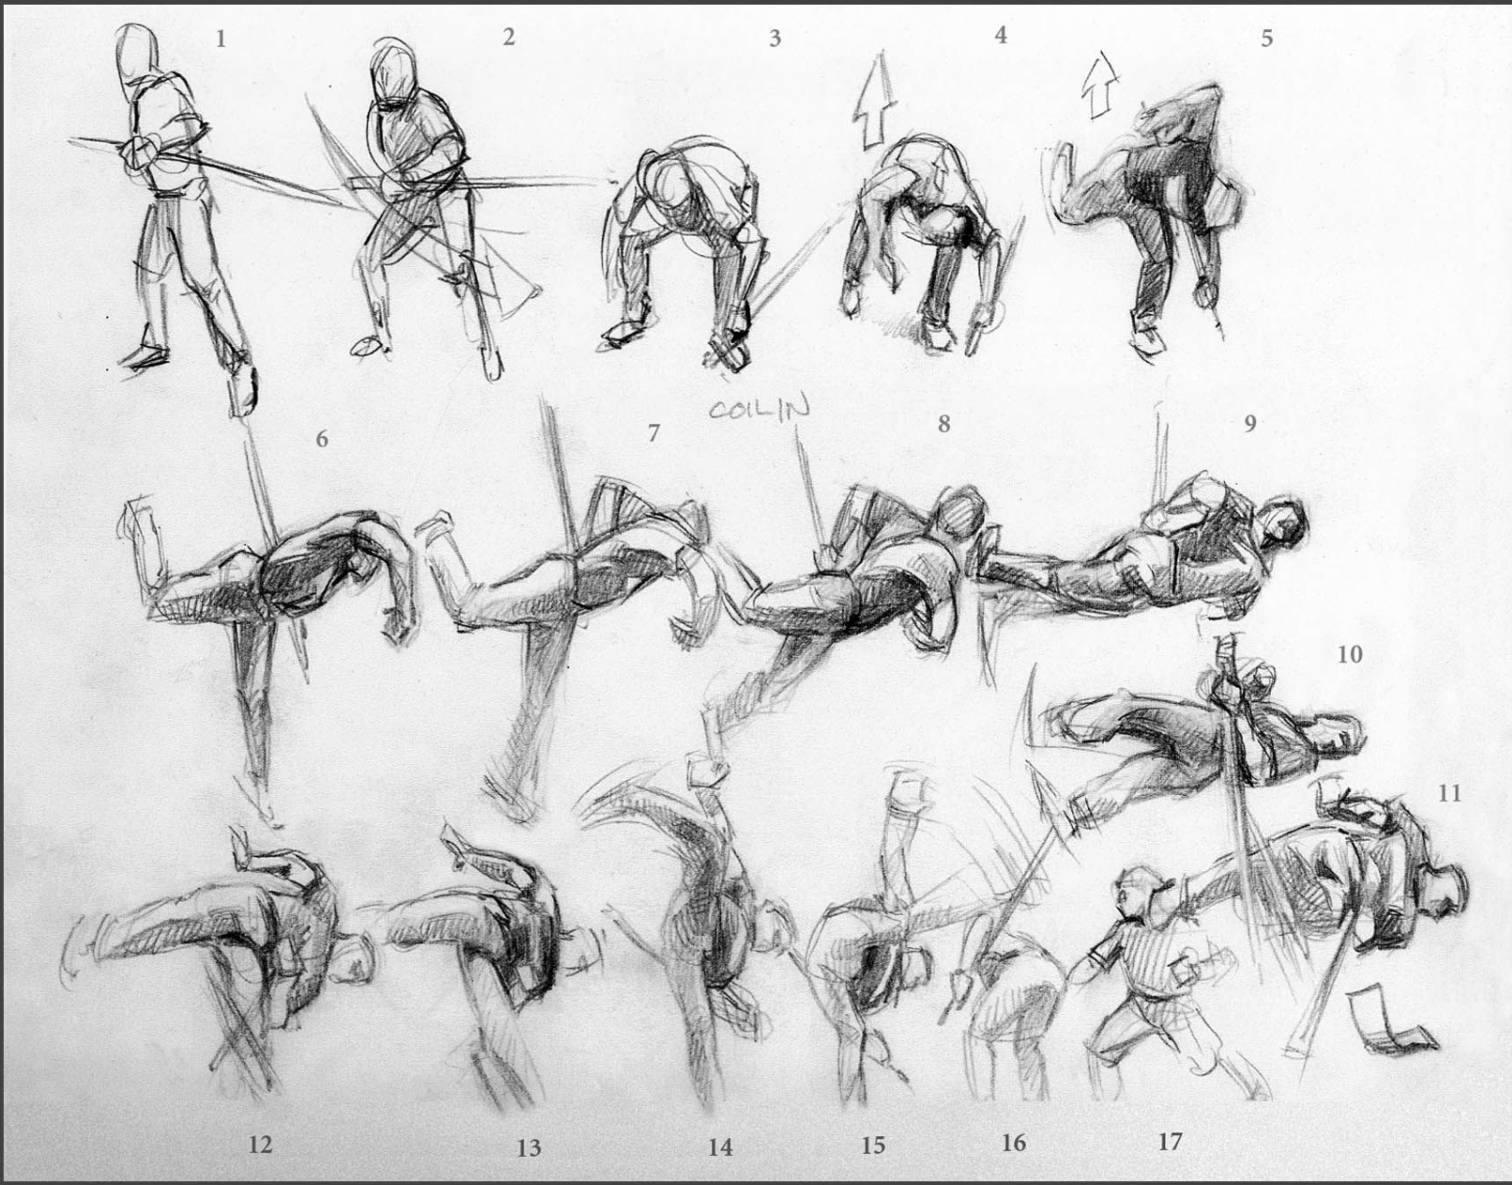
Explain then practice
Butterfly kick

Slide 8
Student introduction
What is your professional background and job title?
What's your experience with Python (or R)?
daily / occasionally / a while ago / a college class / never
What's your current analytic tool or how do you currently deal with data?
Python / PowerBI / Tableau / Excel / Alteryx
Is there a topic of particular interest to you in the class outline or do you have a project in mind-- or: what's your goal for the class?
What do you want out of this class?

Slide 9
Materials
Labs in github repo
https://github.com/BerkeleyDataScienceGroup/8716_material
AWS login
emailed
Backup openAI code
I will give this to you in class but also make your own
Backup student VMs
emailed

Slide 10
Chapter1
-Github repo - lab files and lecture
https://github.com/BerkeleyDataScienceGroup/8716_material
Ch1_demo_GPT_onOpenAI.ipynb
Ch1_exercise1_create_accounts.docx
Ch1_exercise2_openAIplayground.docx
Ch1_exercise3_IntroductiontoGenerativeAI.docx

Slide 11
Chapter2 - GenAI mechanics
-Github repo - lab files and lecture
https://github.com/BerkeleyDataScienceGroup/8716_material
Ch2_demo1_mnist.ipynb
Ch2_demo2_BERT_vector_to_ML.ipynb
Ch2_demo3_openai_embedings.ipynb
Ch2_exercise_embeddings_ML_solution.ipynb
Ch2_exercise_embeddings_ML.ipynb

Slide 12
Chapter2
-Github repo - lab files and lecture
https://github.com/BerkeleyDataScienceGroup/8716_material
Ch2_demo1_mnist.ipynb
Ch2_demo2_BERT_vector_to_ML.ipynb
Ch2_demo3_openai_embedings.ipynb
Ch2_exercise_embeddings_ML_solution.ipynb
Ch2_exercise_embeddings_ML.ipynb

Slide 13
new OpenAI syntax
client = OpenAI(api_key=api_key)
embedding_response = client.embeddings.create(input=input_text,
model="text-embedding-ada-002")
type(embedding_response)
#embedding = embedding_response["data"][0]["Embedding"]
embedding=embedding_response.data[0].embedding
len(embedding)

Slide 14
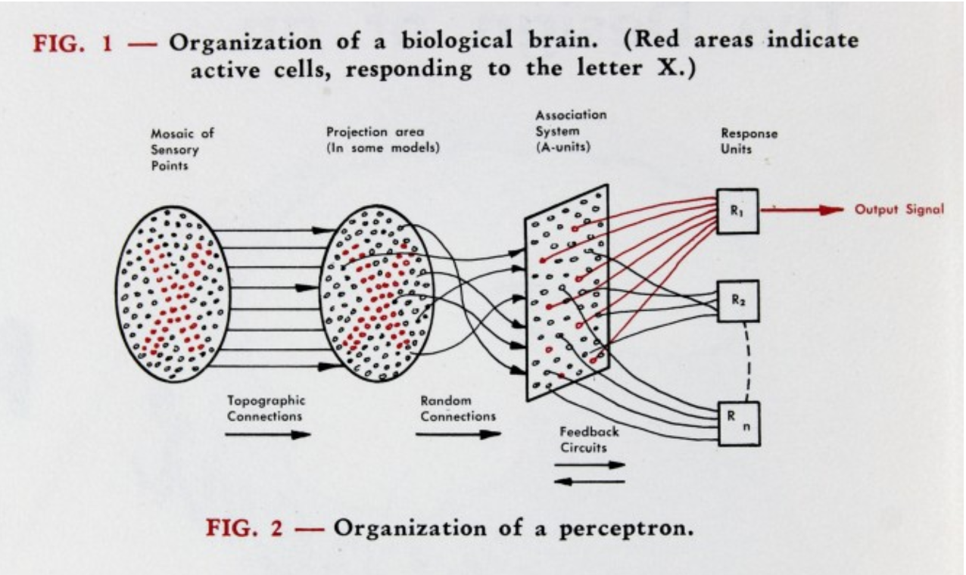
Perceptron
Proposed by Frank Rosenblat in 1958
https://news.cornell.edu/stories/2019/09/professors-perceptron-paved-way-ai-60-years-too-soon

Slide 15
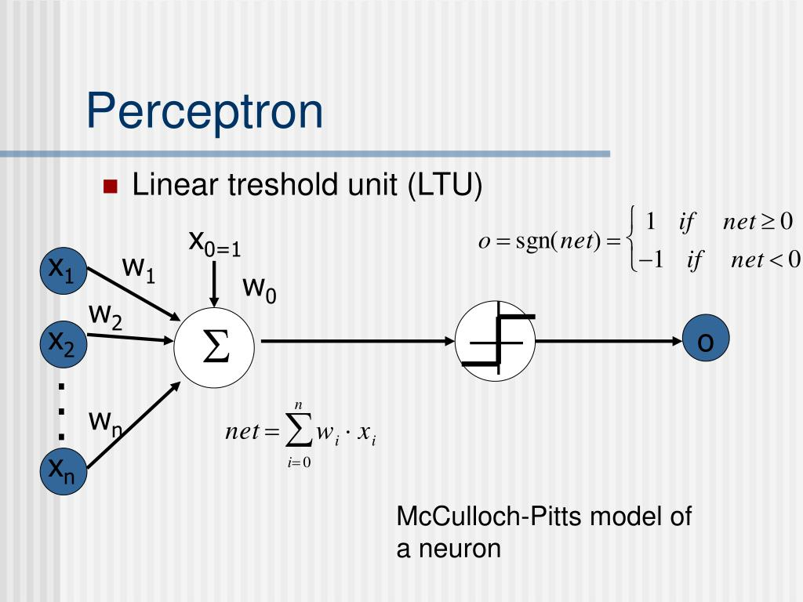
Perceptron
In this perceptron
features (X) are amplified or reduced by (w)weights
the net effect isWxX
weights are modified by training
Outputs are summed in a summation step
The Perceptron trigger is determined by an activation function
pereceptrons are a single unit that are assembled into interconnected “layers”
We predict through “forward propagation” and the network learns through backward propigatoin

Slide 16
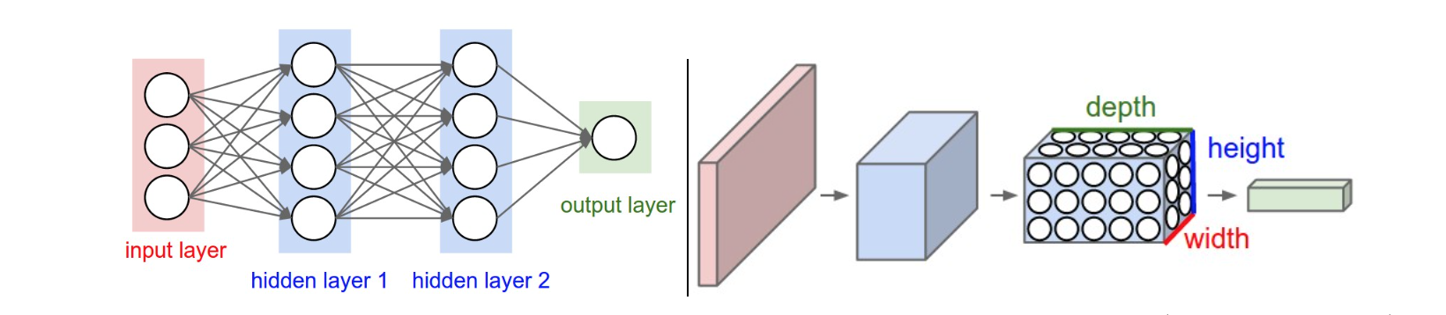
Multi layer Perceptron
Perceptrons are a single unit that are assembled into interconnected “layers”
Adds the ability to predict recognize non-linear patterns
Prediction through “forward propagation”
Learning is done through backward propagation
https://cs231n.github.io/convolutional-networks/

Slide 17
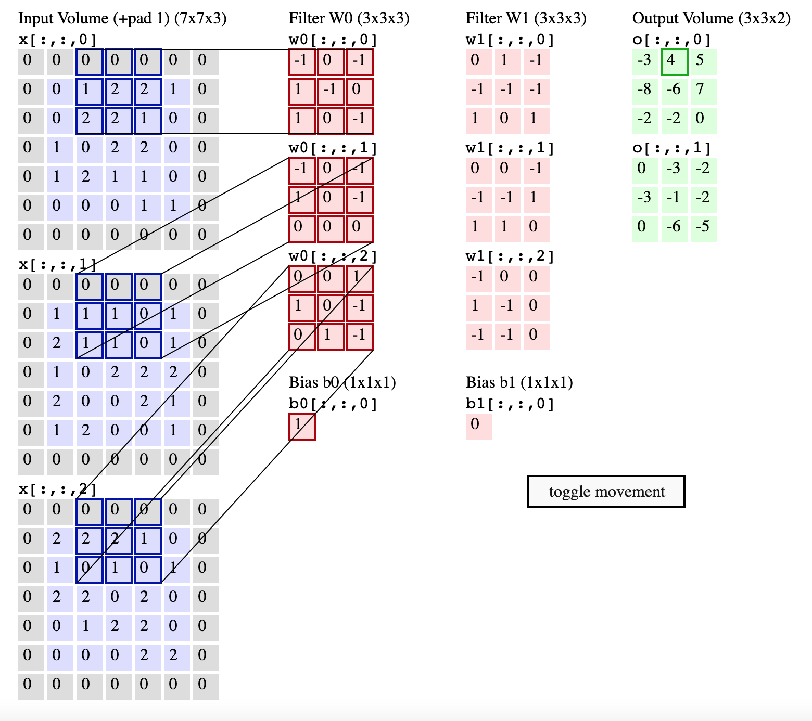
Downsampling
convolutional layers are used for “downsampling”
These are mappling a 3d volume (RGBimage) 7x7x3 to a 3x3x2
https://cs231n.github.io/convolutional-networks/

Slide 18
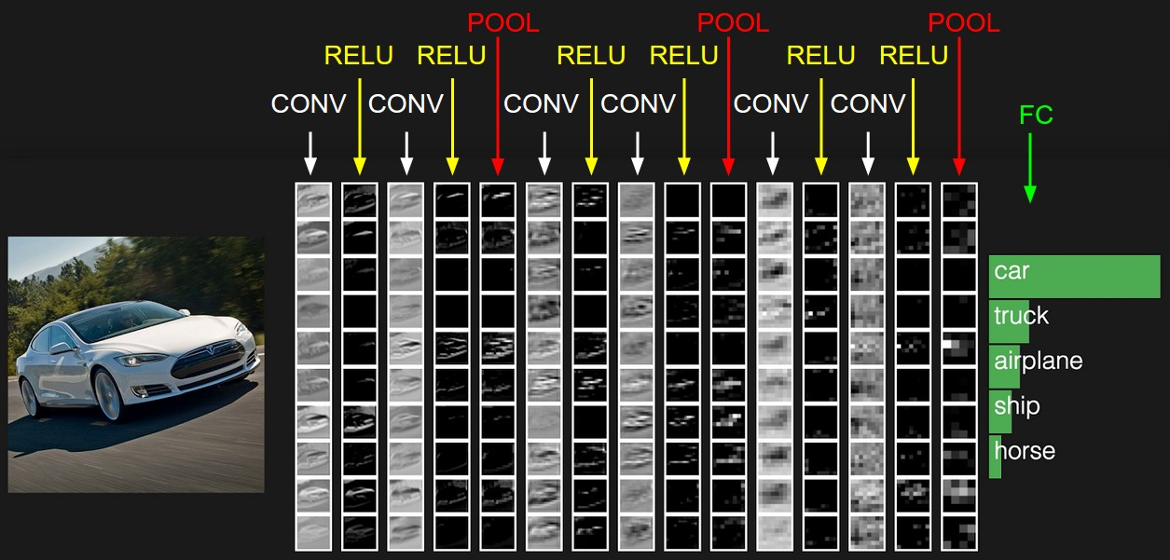
image to probabilities
Layers transform this 3d image to a 1D vector of probabilities
http://cs231n.stanford.edu/

Slide 19
interactive visualization/playgrounds
Tensorflow Demo
https://playground.tensorflow.org/
CS231 live deep learning Demo
http://cs231n.stanford.edu/
GAN lab
https://poloclub.github.io/ganlab/
hidden layer visualzation
https://distill.pub/2017/feature-visualization/

Slide 20
References
Papers
https://news.mit.edu/2023/explained-generative-ai-1109
https://towardsdatascience.com/the-perceptron-3af34c84838c
https://news.cornell.edu/stories/2019/09/professors-perceptron-paved-way-ai-60-years-too-soon
https://cs231n.github.io/convolutional-networks/
https://distill.pub/2017/feature-visualization/
Demos

Slide 21
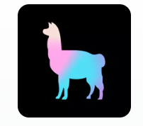

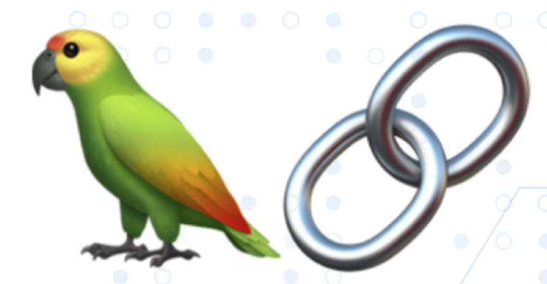
Additional component icons

